Slide 1
Activity in Project Management
An activity is a defined work item or task that needs to be performed to complete a project deliverable. Activities typically come from the Work Breakdown Structure (WBS), which breaks down the project into smaller, manageable components.
Example: In a software development project, activities might include:
Requirements gathering
Designing user interfaces
Writing code for backend
Conducting testing
Deployment

Slide 2
Types of Activities in Project Management
Dependent Activities: Tasks that rely on the completion of other tasks before they can start (e.g., you can't test software until it's been coded).
Independent Activities: Tasks that can be performed regardless of other activities (e.g., preparing documentation while other parts of the system are being developed).
Milestones: Specific points in the project timeline, marking significant events or completion of key tasks.

Slide 3
Activity Planning
Activity planning involves breaking down the project scope into smaller, manageable work packages (via WBS), then identifying and scheduling individual activities that will lead to achieving project goals. This process includes:
Defining the activities: Breaking down deliverables into tasks.
Estimating duration and resources: Identifying how long each activity will take and what resources are needed.
Sequencing the activities: Determining the logical order in which activities should occur.
Assigning responsibilities: Deciding who will carry out each activity.

Slide 4
Activity Sequencing
Activity sequencing is about determining the relationships and dependencies between activities.
Finish-to-Start (FS): The most common dependency where one activity must finish before the next can start.
Example: Testing cannot begin until coding is finished.
Start-to-Start (SS): Two activities must start at the same time or one must start before the other starts.
Example: You can begin data entry as soon as data preparation starts.
Finish-to-Finish (FF): One activity must finish before the other finishes.
Example: The final testing can’t finish until the documentation is completed.
Start-to-Finish (SF): The second task cannot finish until the first task starts.
Example: The system shutdown can't finish until the backup system starts.

Slide 5
Scheduling Activities Using WBS
WBS (Work Breakdown Structure): A hierarchical decomposition of the project deliverables and scope into smaller, more manageable components.
Example: If you’re managing a software development project, your WBS might include:
Phase 1: Requirements Gathering
Phase 2: Design
Phase 3: Development
Phase 4: Testing
Phase 5: Deployment
From the WBS, you can extract activities for further scheduling.

Slide 6
Scheduling activities using Network Planning Model:
Network Planning Model: A network diagram represents the sequence of project activities and their dependencies. It helps identify critical paths and resource allocation.
Example:
Use Activity-on-Node (AON) method for the network diagram where nodes represent tasks and arrows represent dependencies.

Slide 7
Network Diagram in Project Management
Network diagrams help project managers:
Sequence Tasks: They provide a clear understanding of the order in which tasks should be executed, ensuring that work progresses smoothly from one activity to the next.
Identify Dependencies: By showing the relationships between tasks, network diagrams highlight dependencies—where the completion of one task depends on the start or completion of another. This helps in managing task dependencies effectively.
Determine the Critical Path: The critical path is the longest sequence of tasks that determines the shortest possible duration of the project. By identifying the critical path, project managers can focus their efforts on managing and optimizing tasks along this path to ensure timely project completion.
Estimate Project Duration: By analyzing the sequence of tasks and dependencies, project managers can estimate the overall duration of the project more accurately, taking into account potential delays and dependencies.
Allocate Resources: Network diagrams help in resource allocation by providing insights into when and where resources are needed throughout the project lifecycle.

Slide 8
Components of a Project Schedule Network Diagram:
Nodes (Boxes): Nodes represent project activities or tasks. Each node contains information such as the activity name, duration, resources, and any other relevant details.
Arrows (Lines): Arrows represent dependencies between activities. They show the logical sequence in which activities must be performed. The direction of the arrow indicates the flow of work.
Relationships: There are four types of relationships between activities:
Finish-to-Start (FS): The successor activity cannot start until the predecessor activity finishes.
Start-to-Start (SS): The successor activity cannot start until the predecessor activity starts.
Finish-to-Finish (FF): The successor activity cannot finish until the predecessor activity finishes.
Start-to-Finish (SF): The successor activity cannot finish until the predecessor activity starts.
Critical Path: The critical path is the longest sequence of dependent activities that determine the shortest possible duration for completing the project. Activities on the critical path have zero slack or float time, meaning any delay in these activities will directly impact the project's overall timeline.

Slide 9
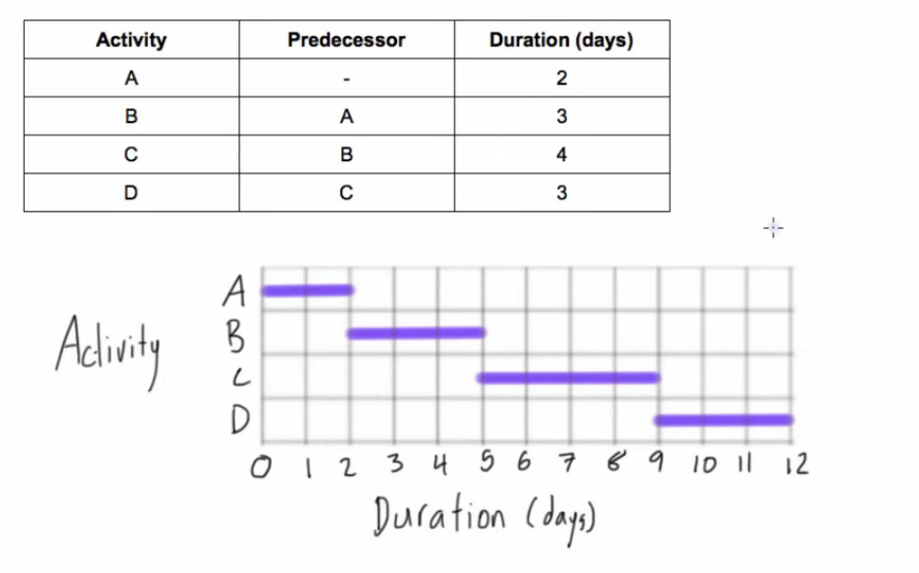
Gantt Chart

Slide 10
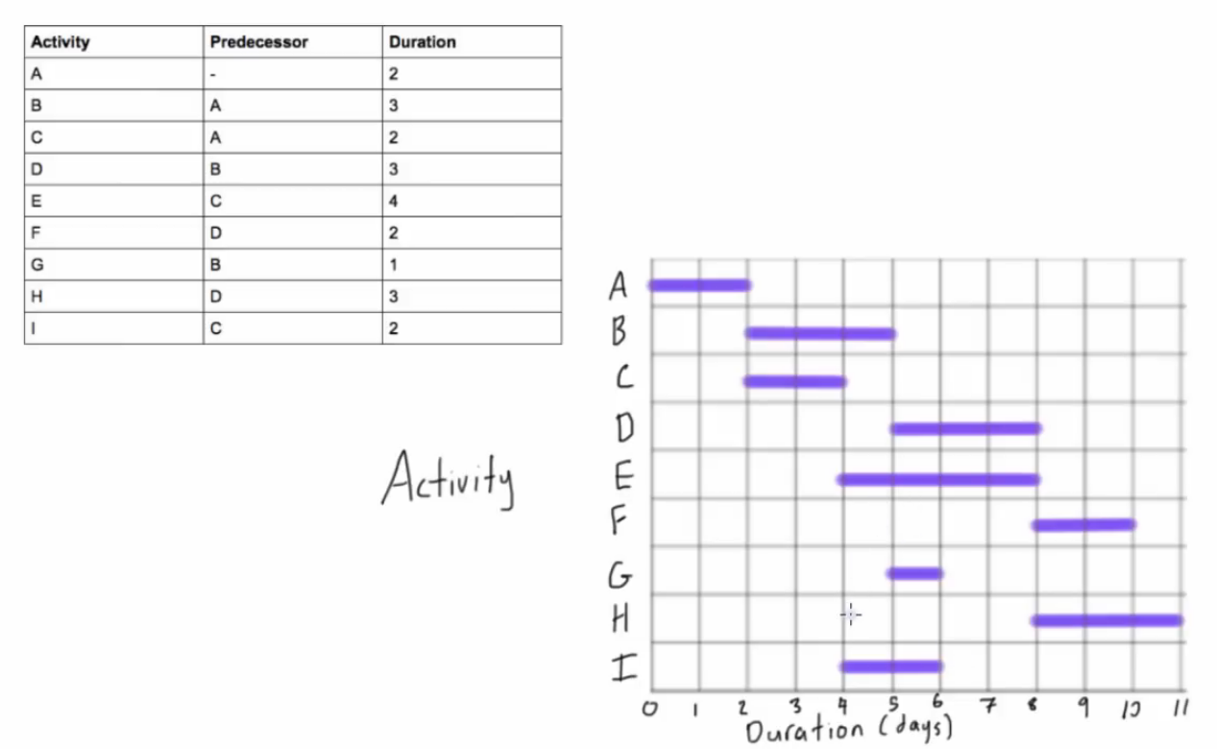

Slide 11
PDM Network Diagram
A PDM (Precedence Diagramming Method) network diagram is a type of project scheduling diagram where activities (or tasks) are represented as nodes, and the relationships between them (dependencies) are shown using arrows. The PDM method is widely used in project management, especially for creating project schedules and understanding task dependencies.
Key Components of a PDM Network Diagram:
Nodes represent the tasks or activities in the project.
Arrows represent the dependencies (relationships) between tasks.
The diagram helps determine the project’s critical path and shows which tasks must be completed before others can start.

Slide 12
Types of Dependencies in PDM:
Finish-to-Start (FS): The most common type, where Task A must finish before Task B can start.
Example: You must finish building the foundation (Task A) before you can start framing the structure (Task B).
Start-to-Start (SS): Task B cannot start until Task A has started.
Example: The "painting" task cannot start until the "drywall installation" has started (both can overlap but must start together).
Finish-to-Finish (FF): Task B cannot finish until Task A finishes.
Example: The "QA Testing" task cannot finish until the "development" task finishes.
Start-to-Finish (SF): Task B cannot finish until Task A starts (less common).
Example: The backup system (Task B) cannot finish until the primary system upgrade (Task A) has started.

Slide 13
Steps to Create a PDM Network Diagram:
List the Tasks/Activities: Break down the project into smaller tasks or activities.
Identify Dependencies: Determine how tasks relate to each other (which tasks must finish before others can start).
Draw the Network: Use nodes (rectangles or circles) for tasks, and arrows for dependencies.
Label the Tasks: Write the name or description of each task in the nodes.
Determine Critical Path: Identify the longest sequence of dependent tasks that determines the project duration.

Slide 14
Critical Path
The Critical Path is a key concept in project management and refers to the sequence of tasks or activities that must be completed on time in order to ensure the project finishes on schedule.
The critical path is the longest path through the project’s schedule and has zero float (or slack), meaning any delay in critical path activities will directly result in a delay in the overall project.
Key Characteristics of the Critical Path:
Longest Duration: The critical path takes the longest total time to complete, and it directly impacts the project’s overall timeline.
No Slack/Float: Tasks on the critical path cannot be delayed without delaying the entire project.
Determines Project Duration: The total time of the critical path determines the minimum time required to complete the project.

Slide 15
How to Identify the Critical Path?
To identify the critical path in a project, follow these steps:
List All Activities: Break the project down into smaller tasks and list all the activities required to complete the project.
Define Task Dependencies: Identify which tasks depend on others. For example, some tasks must be completed before others can start.
Estimate Duration: Estimate the duration of each task or activity.
Create a Network Diagram: Use a Precedence Diagramming Method (PDM) or Arrow Diagramming Method (ADM) to visualize the sequence of tasks and dependencies.
Perform the Forward Pass: Calculate the Earliest Start (ES) and Earliest Finish (EF) times for each task, moving forward through the project.
Perform the Backward Pass: Calculate the Latest Start (LS) and Latest Finish (LF) times for each task, moving backward through the project.
Calculate the Float: For each task, calculate the Total Float (or Slack) to determine how much flexibility there is in the schedule. Tasks on the critical path will have zero float.
Identify the Critical Path: The critical path is the sequence of tasks that have the longest duration and the zero float. It determines the project’s overall duration.

Slide 16
Total & Free Floats
Why is the Critical Path Important?
Project Scheduling: The critical path determines the minimum time required to complete the project. If a task on the critical path is delayed, the whole project is delayed.
Resource Allocation: The critical path highlights which tasks require immediate attention and focus, allowing project managers to allocate resources effectively.
Risk Management: Knowing the critical path helps identify potential risks. Tasks on the critical path are high-risk and need to be carefully monitored to avoid delays.
Critical Path and Float
Total Float (or Slack): The amount of time that you can delay a task without delaying the overall project.
Formula: Total Float = Latest Finish (LF) – Earliest Finish (EF)
Free Float: The amount of time a task can be delayed without delaying the early start of any successor task.

Slide 17
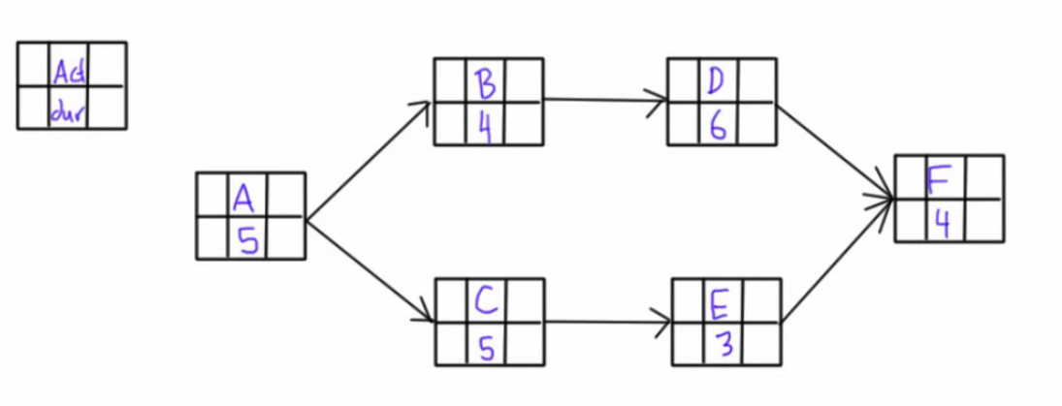
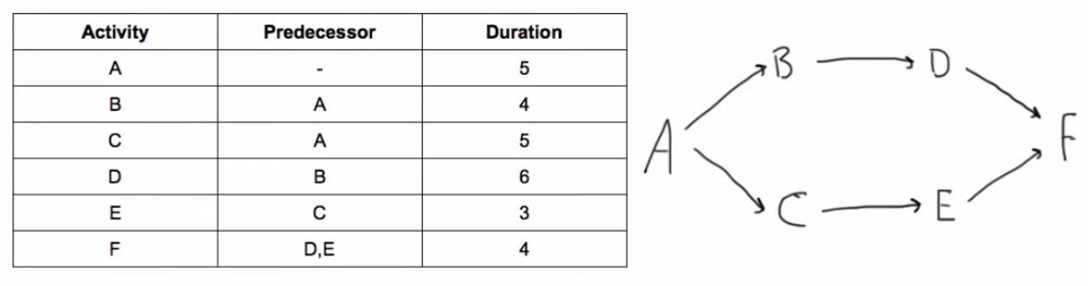
PDM

Slide 18
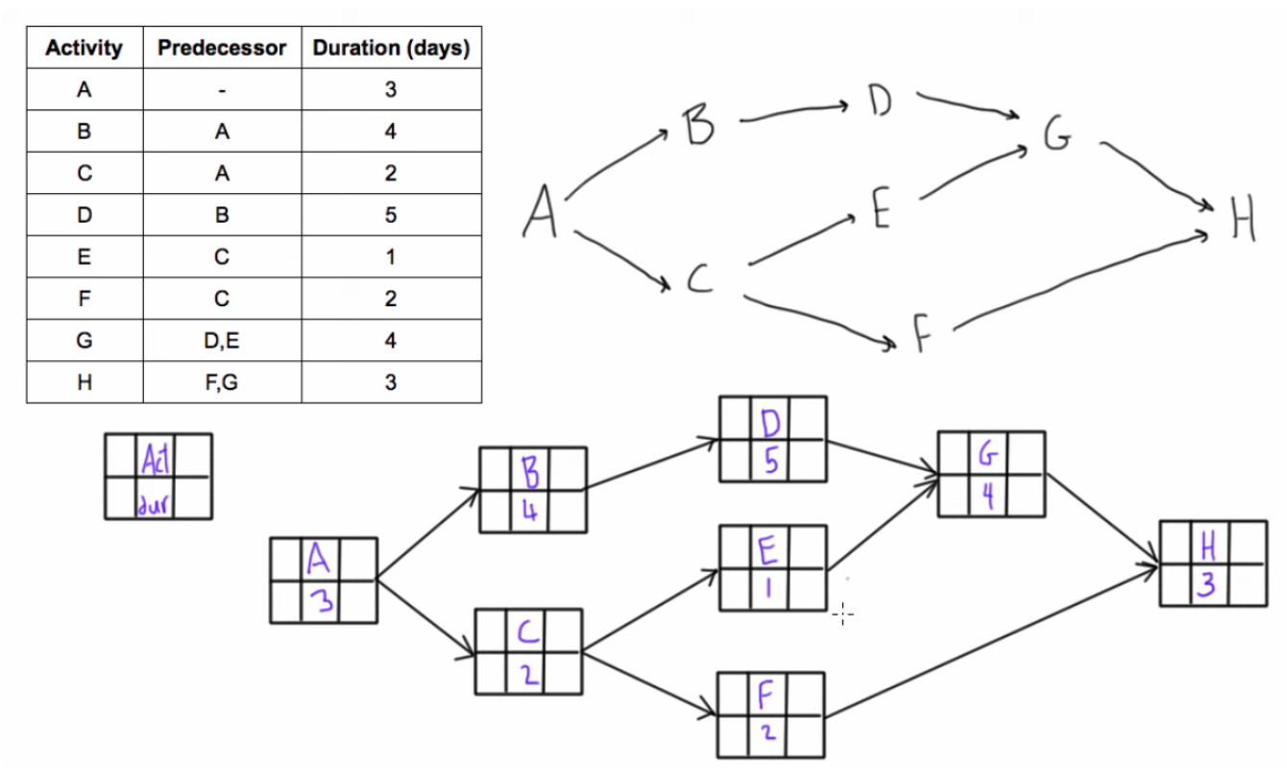
PDM

Slide 19
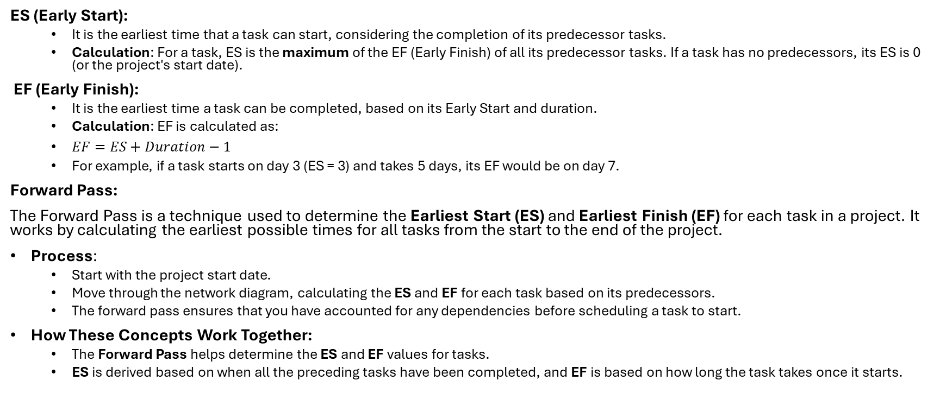
Forward Pass
ES (Early Start):
It is the earliest time that a task can start, considering the completion of its predecessor tasks.
Calculation: For a task, ES is the maximum of the EF (Early Finish) of all its predecessor tasks. If a task has no predecessors, its ES is 0 (or the project's start date).
EF (Early Finish):
It is the earliest time a task can be completed, based on its Early Start and duration.
Calculation: EF is calculated as:
$EF=ES+Duration−1$
For example, if a task starts on day 3 (ES = 3) and takes 5 days, its EF would be on day 7.
Forward Pass:
The Forward Pass is a technique used to determine the Earliest Start (ES) and Earliest Finish (EF) for each task in a project. It works by calculating the earliest possible times for all tasks from the start to the end of the project.
Process:
Start with the project start date.
Move through the network diagram, calculating the ES and EF for each task based on its predecessors.
The forward pass ensures that you have accounted for any dependencies before scheduling a task to start.
How These Concepts Work Together:
The Forward Pass helps determine the ES and EF values for tasks.
ES is derived based on when all the preceding tasks have been completed, and EF is based on how long the task takes once it starts.

Slide 20
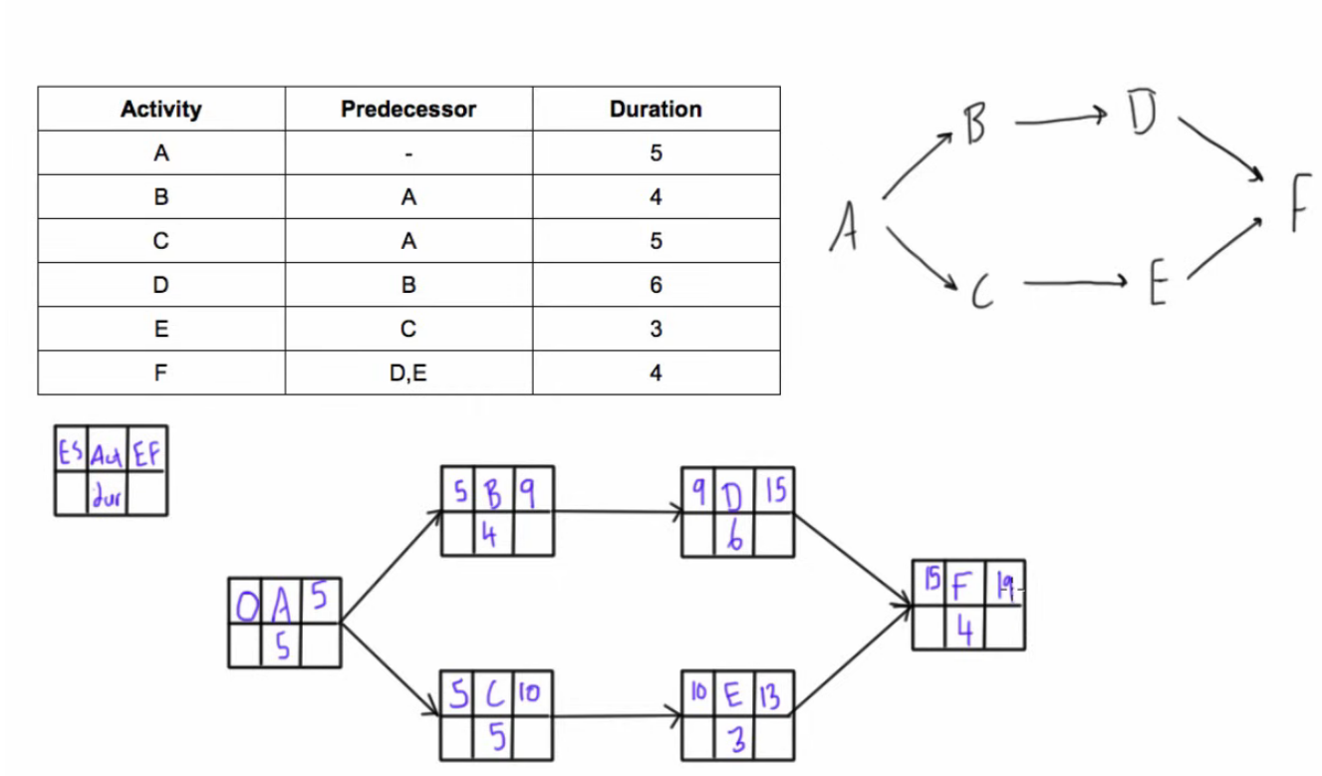
PDM – ES, EF – Forward Pass

Slide 21
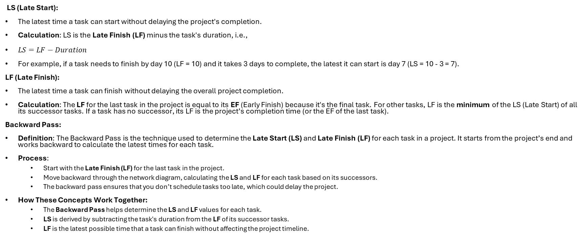
PDM – LS LF – Backward Pass
LS (Late Start):
The latest time a task can start without delaying the project's completion.
Calculation: LS is the Late Finish (LF) minus the task's duration, i.e.,
$LS=LF−Duration$
For example, if a task needs to finish by day 10 (LF = 10) and it takes 3 days to complete, the latest it can start is day 7 (LS = 10 - 3 = 7).
LF (Late Finish):
The latest time a task can finish without delaying the overall project completion.
Calculation: The LF for the last task in the project is equal to its EF (Early Finish) because it's the final task. For other tasks, LF is the minimum of the LS (Late Start) of all its successor tasks. If a task has no successor, its LF is the project’s completion time (or the EF of the last task).
Backward Pass:
Definition: The Backward Pass is the technique used to determine the Late Start (LS) and Late Finish (LF) for each task in a project. It starts from the project’s end and works backward to calculate the latest times for each task.
Process:
Start with the Late Finish (LF) for the last task in the project.
Move backward through the network diagram, calculating the LS and LF for each task based on its successors.
The backward pass ensures that you don’t schedule tasks too late, which could delay the project.
How These Concepts Work Together:
The Backward Pass helps determine the LS and LF values for each task.
LS is derived by subtracting the task's duration from the LF of its successor tasks.
LF is the latest possible time that a task can finish without affecting the project timeline.

Slide 22
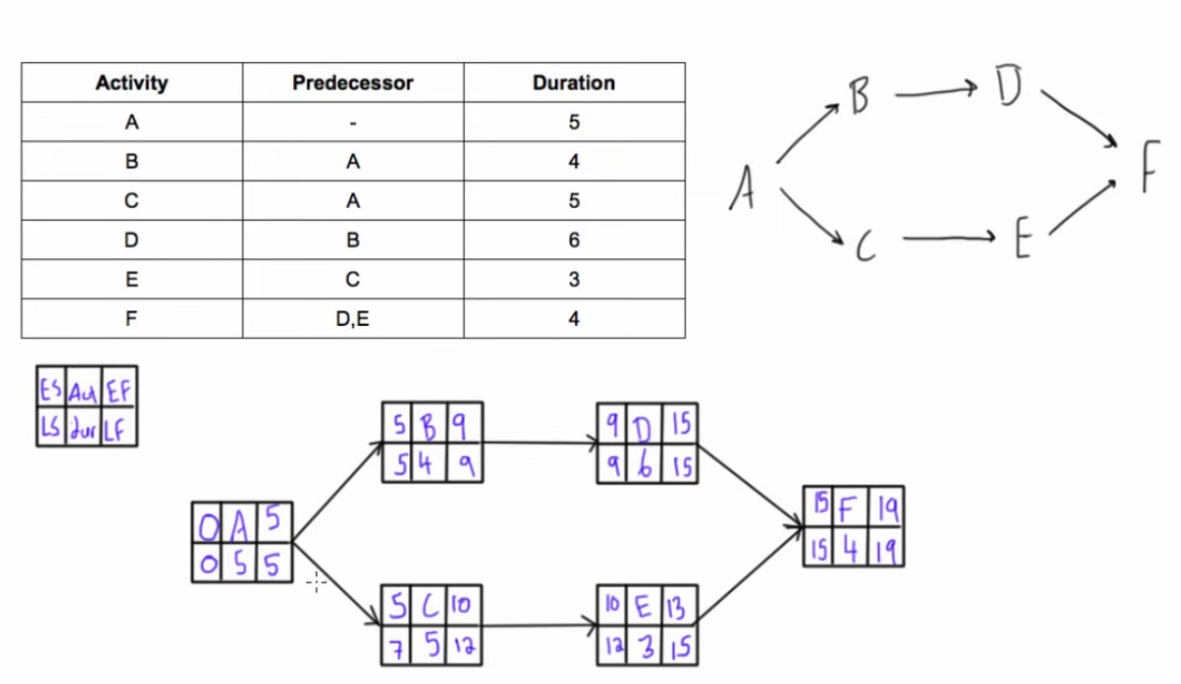
PDM – LS LF – Backward Pass

Slide 23
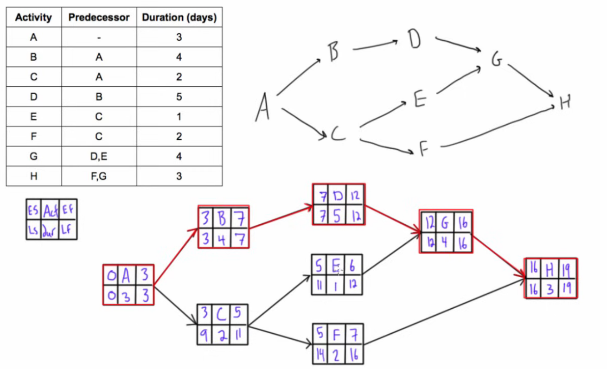
PDM

Slide 24
CPM – Critical Path Method
A CPM (Critical Path Method) Network Diagram is a visual representation of a project's tasks and their dependencies. It helps project managers understand the relationships between tasks, determine the critical path, and identify where the project might be delayed.
Key Elements of a CPM Network Diagram:
Nodes (Boxes):
Each node represents a task or activity in the project. It includes the task name, duration, and sometimes its ES, EF, LS, and LF times (depending on the level of detail).
Arrows (Dependencies):
The arrows between nodes represent dependencies (relationships) between tasks. They show which tasks must be completed before others can start.
Paths:
The network diagram is made up of different paths, each representing a sequence of tasks connected by dependencies. The critical path is the longest path in terms of duration, and any delay along this path will delay the entire project.
Critical Path:
The critical path is the longest sequence of dependent tasks in the project. It dictates the project’s minimum completion time. Tasks on the critical path have zero slack.

Slide 25
CPM – Critical Path Method
Steps to Create a CPM Network Diagram:
Identify Tasks: List all tasks and their durations.
Determine Dependencies: Identify which tasks must be completed before others can begin.
Draw the Network: Represent tasks as nodes and dependencies as arrows.
Perform Forward and Backward Passes: Calculate ES, EF, LS, and LF for each task.
Identify the Critical Path: The critical path is the path with the longest total duration.

Slide 26
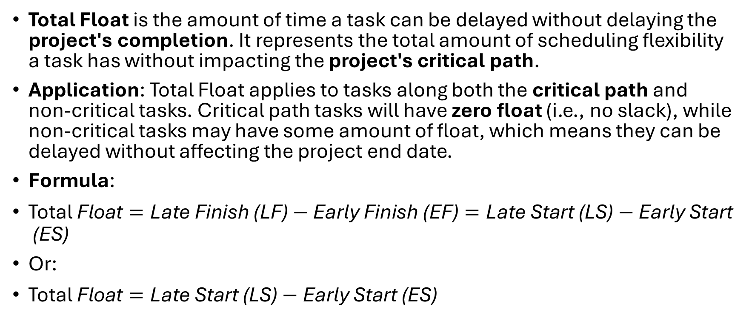
Total Float (Slack)
Total Float is the amount of time a task can be delayed without delaying the project's completion. It represents the total amount of scheduling flexibility a task has without impacting the project's critical path.
Application: Total Float applies to tasks along both the critical path and non-critical tasks. Critical path tasks will have zero float (i.e., no slack), while non-critical tasks may have some amount of float, which means they can be delayed without affecting the project end date.
Formula:
$\text{Total} \text{Float}=\text{Late} \text{Finish}\text{ (}\text{LF}\text{)}−\text{Early} \text{Finish}\text{ (}\text{EF}\text{)}=\text{Late} \text{Start}\text{ (}\text{LS}\text{)}−\text{Early} \text{Start}\text{ (}\text{ES}\text{)}$
Or:
$\text{Total} \text{Float}=\text{Late} \text{Start}\text{ (}\text{LS}\text{)}−\text{Early} \text{Start}\text{ (}\text{ES}\text{)}$

Slide 27
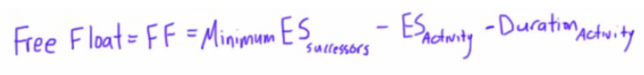
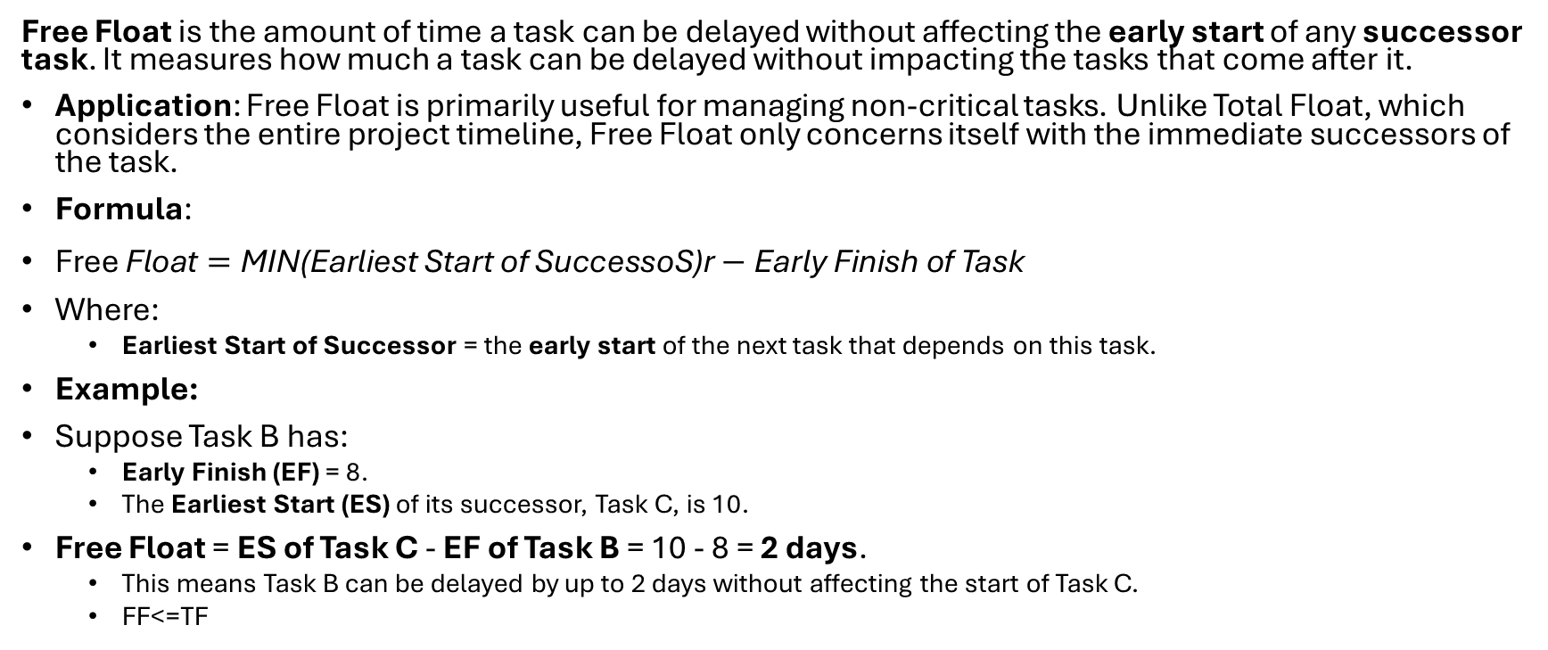
Free Float
Free Float is the amount of time a task can be delayed without affecting the early start of any successor task. It measures how much a task can be delayed without impacting the tasks that come after it.
Application: Free Float is primarily useful for managing non-critical tasks. Unlike Total Float, which considers the entire project timeline, Free Float only concerns itself with the immediate successors of the task.
Formula:
$\text{Free} \text{Float}=\text{MIN}\text{(}\text{Earliest} \text{Start} \text{of} \text{SuccessoS}\text{)}\text{r}−\text{Early} \text{Finish} \text{of} \text{Task}$
Where:
Earliest Start of Successor = the early start of the next task that depends on this task.
Example:
Suppose Task B has:
Early Finish (EF) = 8.
The Earliest Start (ES) of its successor, Task C, is 10.
Free Float = ES of Task C - EF of Task B = 10 - 8 = 2 days.
This means Task B can be delayed by up to 2 days without affecting the start of Task C.
FF<=TF

Slide 28
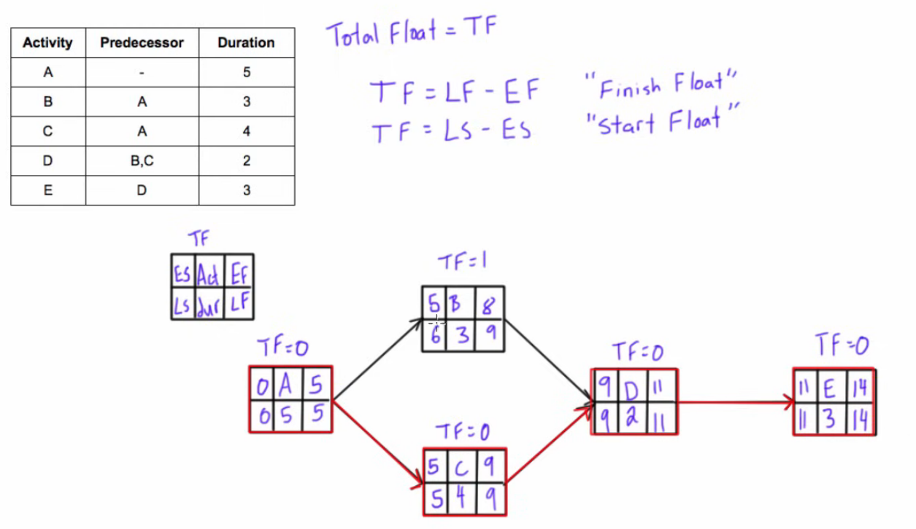

Slide 29
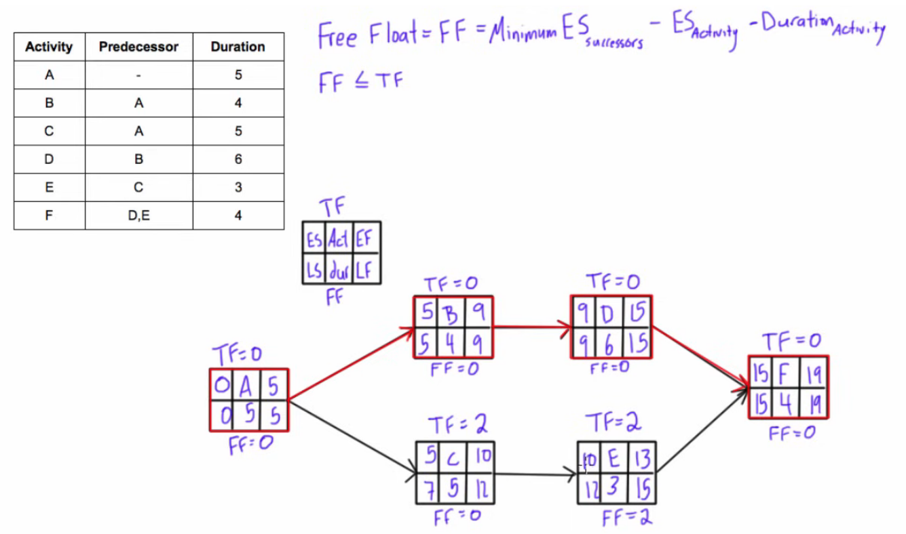

Slide 30
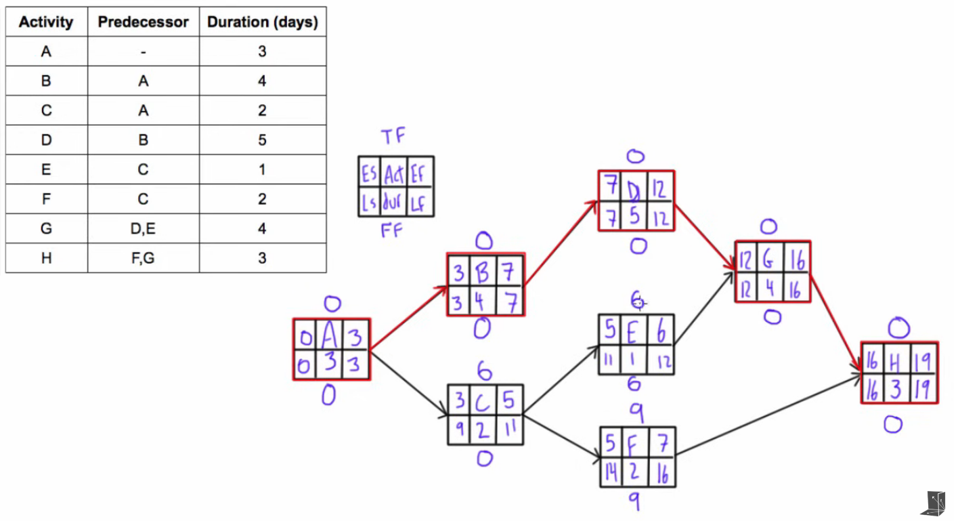

Slide 31
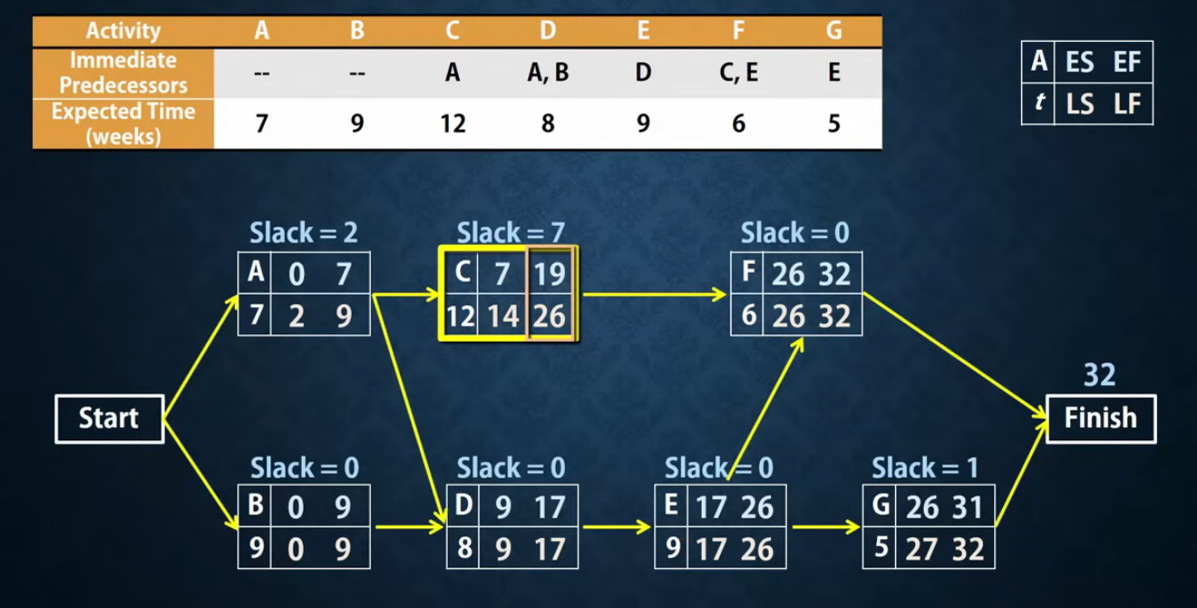

Slide 32
CPM
Critical Path Method (CPM) Made Simple: A Complete Guide

Slide 33
Network Diagram
A project network diagram graphically illustrates:
All project activities
The order in which activities must be performed
Dependencies between activities
It is a key input for:
Schedule development
Critical Path Method (CPM)
Identifying schedule risks

Slide 34
Components of a Network Diagram
1. Activities (Tasks)
Individual units of work in the project
Usually derived from the Work Breakdown Structure (WBS)
Shown as nodes (boxes) or arrows, depending on diagram type
2. Dependencies (Logical Relationships)
Show how activities are related:
Finish-to-Start (FS) – successor starts after predecessor finishes (most common)
Start-to-Start (SS) – successor starts when predecessor starts
Finish-to-Finish (FF) – successor finishes when predecessor finishes
Start-to-Finish (SF) – successor finishes after predecessor starts (rare)

Slide 35
Components of a Network Diagram
3. Nodes
Represent activities (in most modern diagrams)
May contain:
Activity name or ID
Duration
Early Start (ES)
Early Finish (EF)
Late Start (LS)
Late Finish (LF)
Float/Slack
4. Arrows (Links)
Indicate dependency direction
Show sequence of work
5. Milestones (optional)
Significant events or checkpoints
Zero duration
Example: “Design Approved”

Slide 36
Types of Network Diagrams
1. Precedence Diagramming Method (PDM) – Most Common - AON
Activities are represented as nodes (boxes)
Arrows show dependencies
Supports all four dependency types (FS, SS, FF, SF)
2. Arrow Diagramming Method (ADM) - AOA
Activities are shown as arrows
Nodes represent start/end points
Only supports Finish-to-Start (FS) relationships
Uses dummy activities (dotted arrows) to show logic
Largely outdated

Slide 37
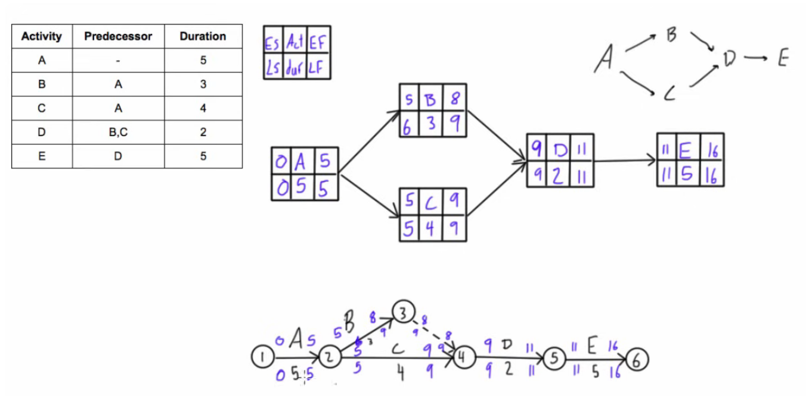

Slide 38
How to find the critical path in a project:
Step 1: Identify all tasks required to complete the project
Step 2: Determine the sequence of tasks
Step 3: Estimate the duration of each task
Step 4: Draw a network diagram
Step 5: Identify the critical path
Step 6: Calculate the float
Step 7: Monitor the critical path

Slide 39
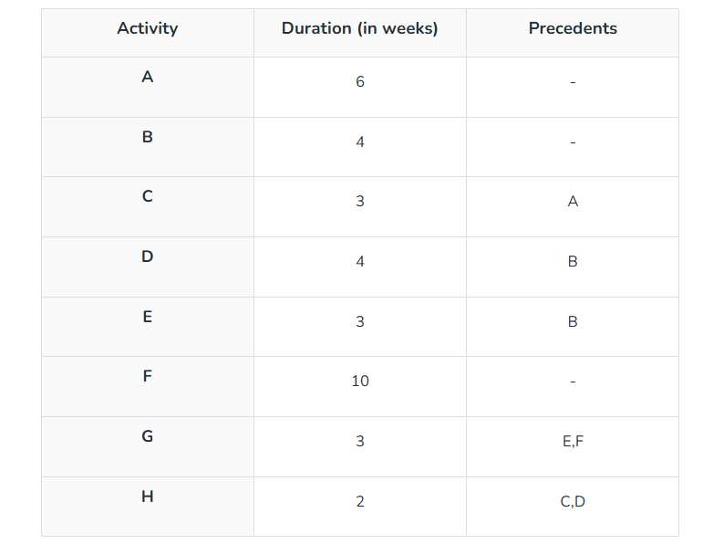

Slide 40
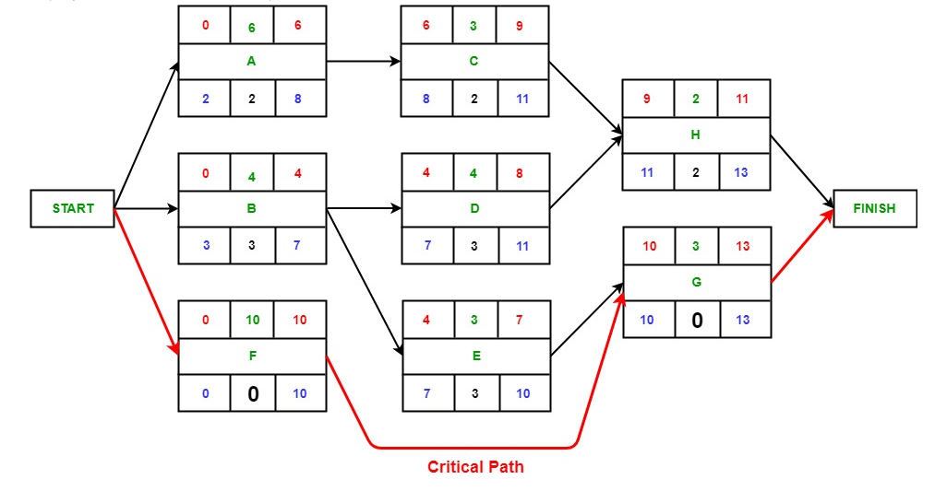

Slide 41
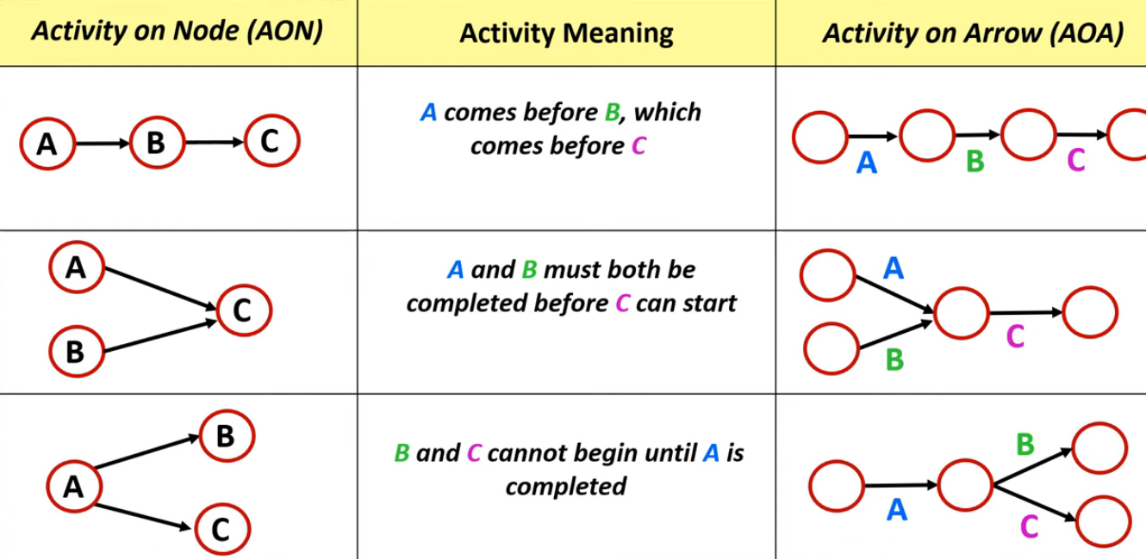
AON vs AOA

Slide 42
AOA
AOA (Activity on Arrow)
In AOA:
Activities → arrows
Events → nodes (circles)
Uses dummy activities
Only Finish-to-Start (FS) relationships allowed
Characteristics of AOA
Also called Arrow Diagramming Method (ADM)
Less flexible
Largely outdated

Slide 43
AOA
Dummy activities should follow these rules:
Used only when necessary
Must not represent real work
Must have zero duration
Should not form a critical path
Each activity must have:
One unique start event
One unique end event
Dummy activities are used to:
Show dependency, not sequence of work
Two activities cannot have same start and end events without a dummy

Slide 44
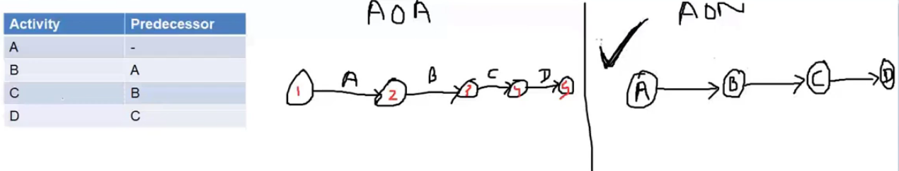

Slide 45
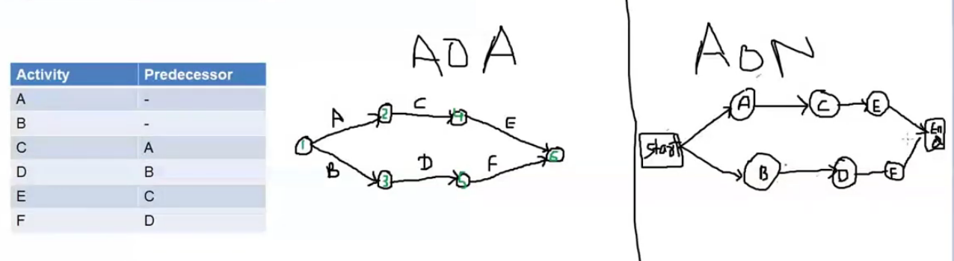

Slide 46
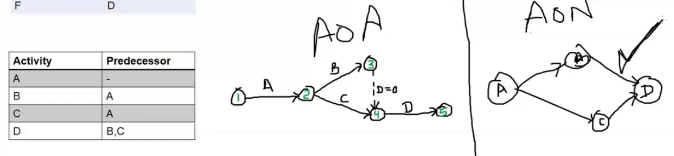

Slide 47
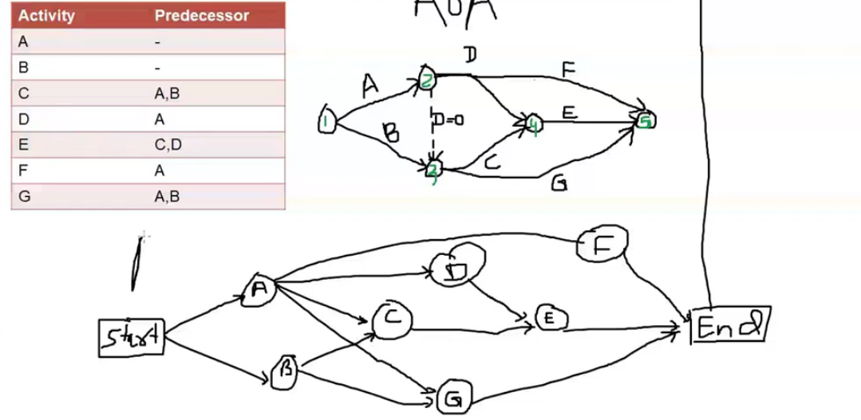

Slide 48
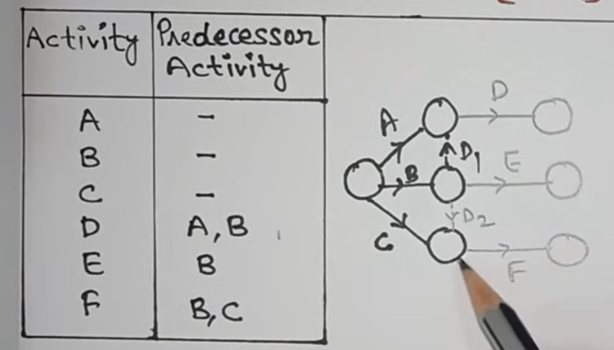
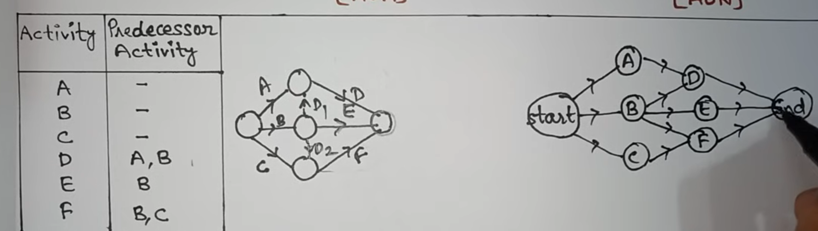

Slide 49
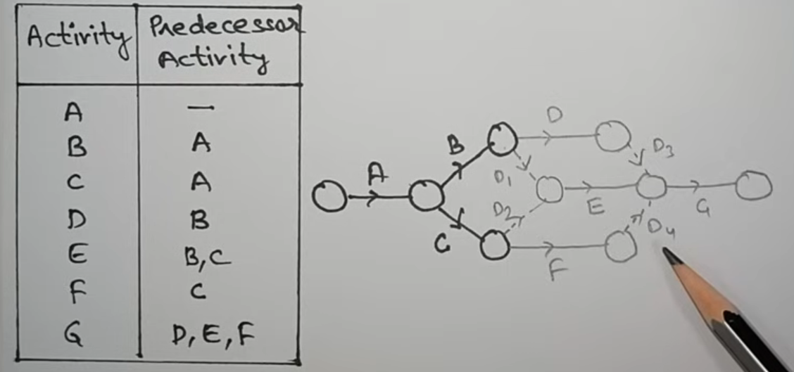

Slide 50
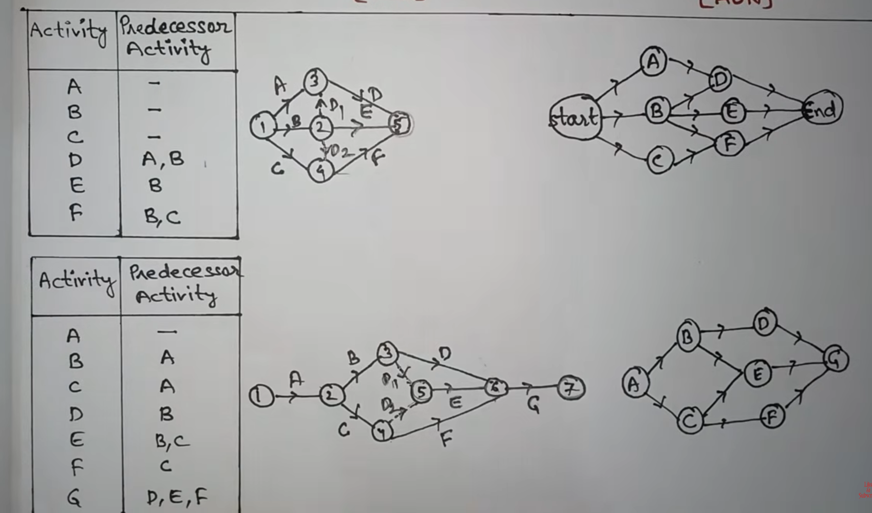

Slide 51
PERT
PERT (Program Evaluation and Review Technique)
PERT is a probabilistic project scheduling technique used to plan, schedule, and control projects when activity durations are uncertain.
It is especially useful for new, complex, or research-oriented projects.
Key Features of PERT
Deals with uncertainty in activity durations
Uses probability and statistics
Event-oriented technique
Mainly focuses on time, not cost
Suitable for non-repetitive projects
PERT Network Diagram
PERT uses a network diagram, traditionally based on Activity-on-Arrow (AOA):
Activities → arrows
Events → nodes (circles)
Dummy activities may be used

Slide 52
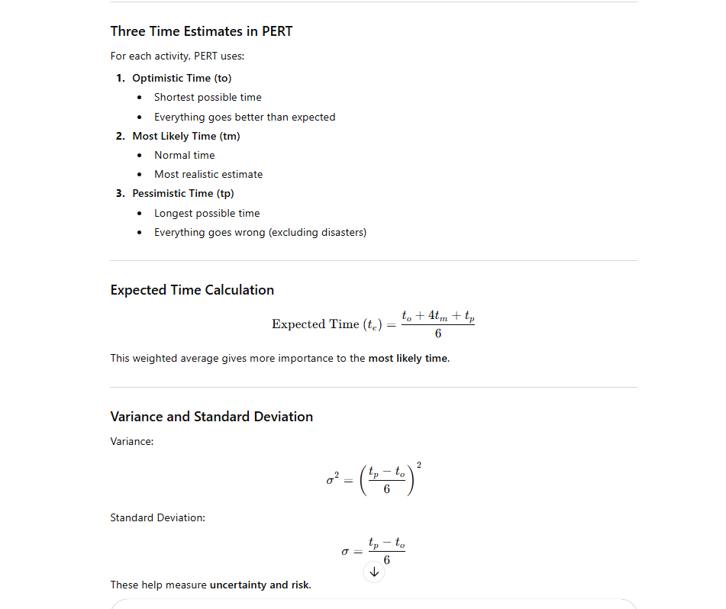

Slide 53

PERT
Steps in PERT Analysis
Identify all activities
Determine precedence relationships
Estimate to, tm, tp for each activity
Calculate expected time and variance
Draw the PERT network diagram
Identify the critical path
Compute expected project duration
Calculate probability of completing by a target date
Probability of Project Completion
PERT uses normal distribution (approximation).
$Z=\frac{T_{s}−T_{e}}{σ_{cp}}$
Where:
$T_{s}$= Scheduled (target) time
$T_{e}$= Expected project duration
$σ_{cp}$= Standard deviation of critical path
Z-value is used with normal distribution tables.

Slide 54
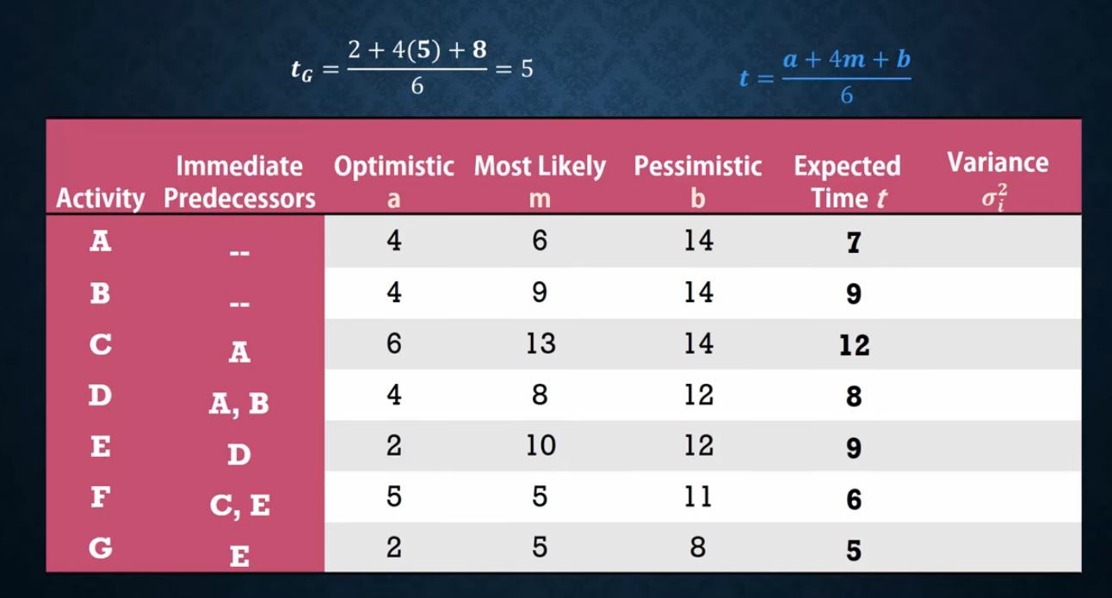
PERT

Slide 55
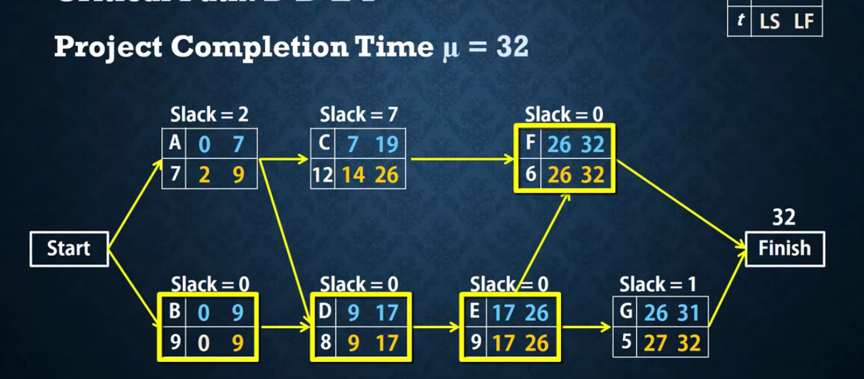
PERT

Slide 56
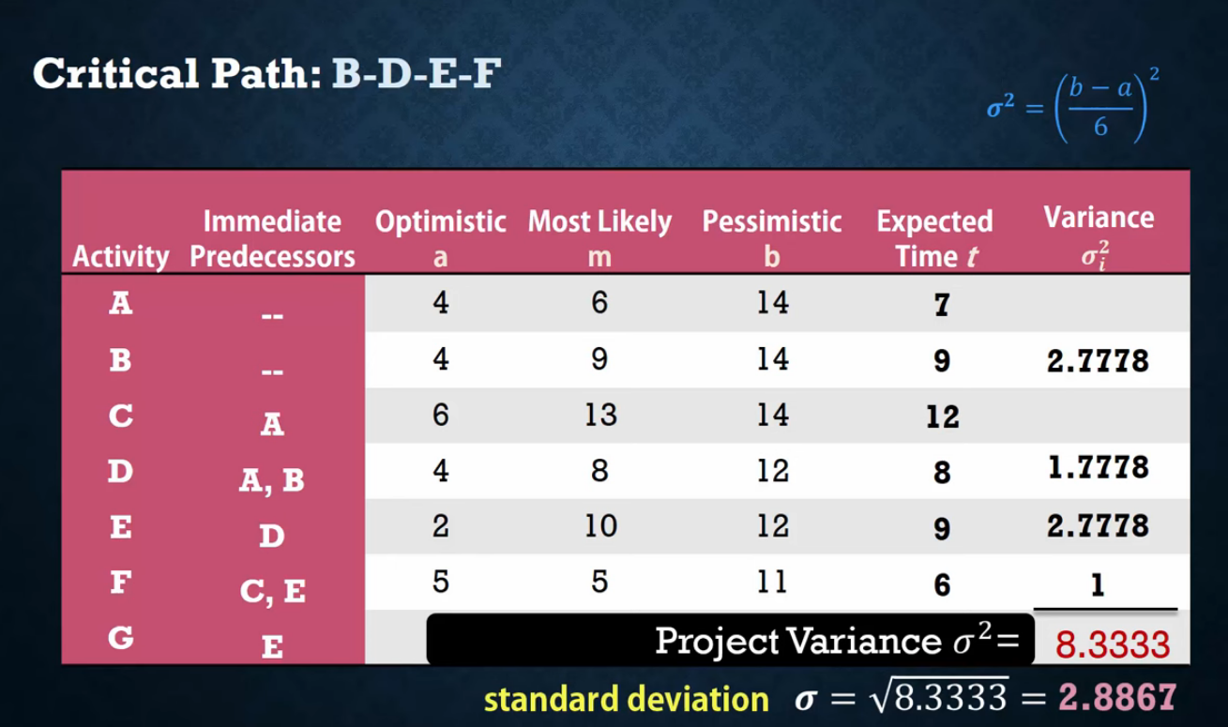

Slide 57
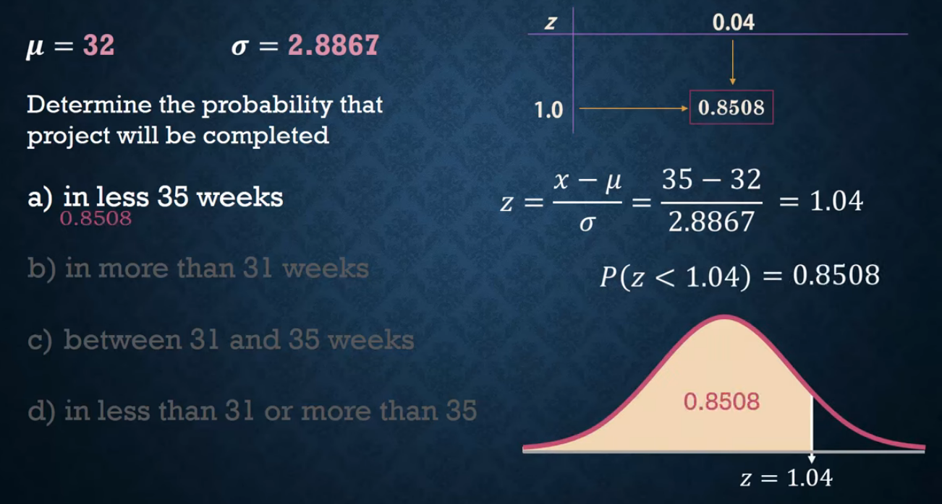

Slide 58
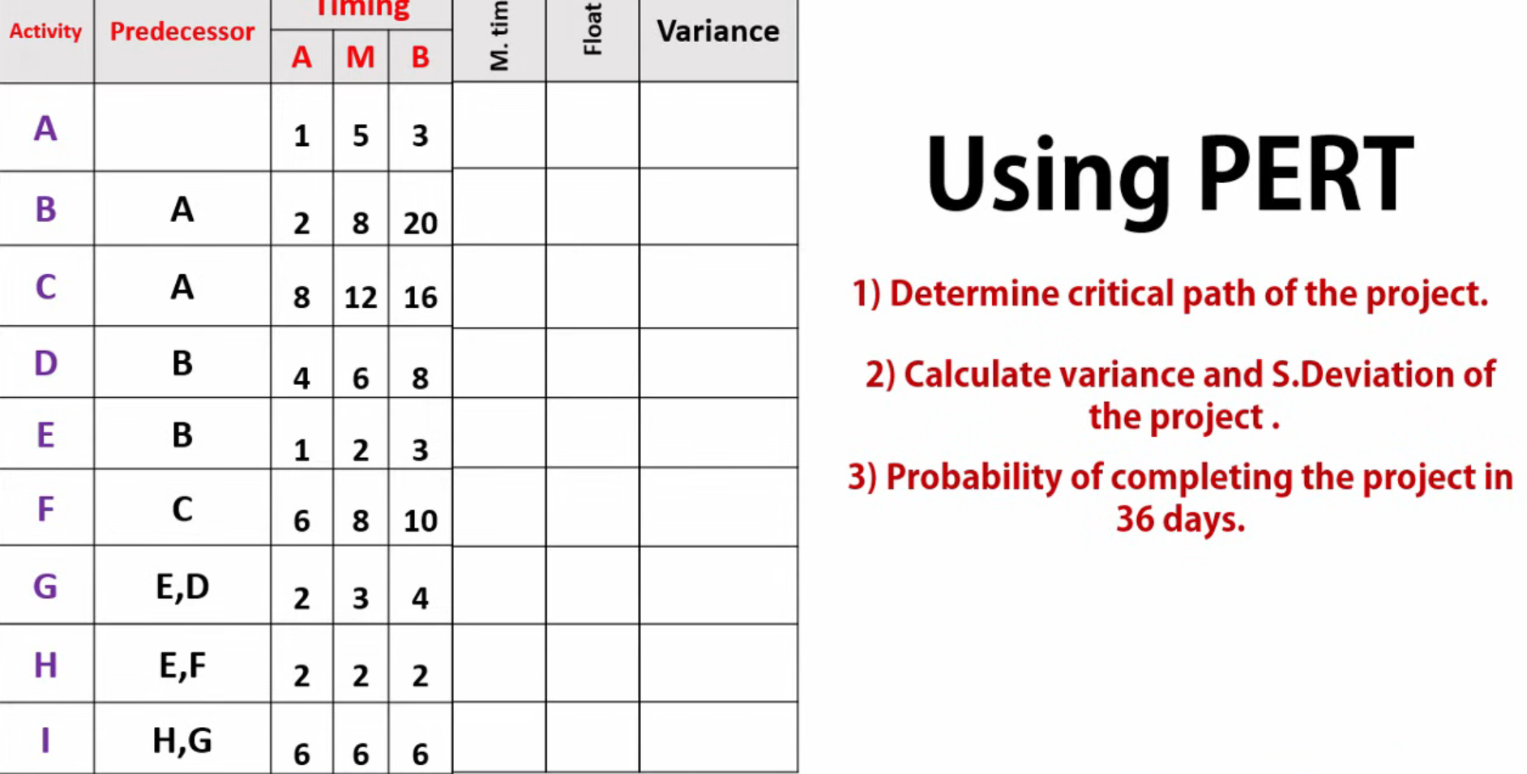

Slide 59
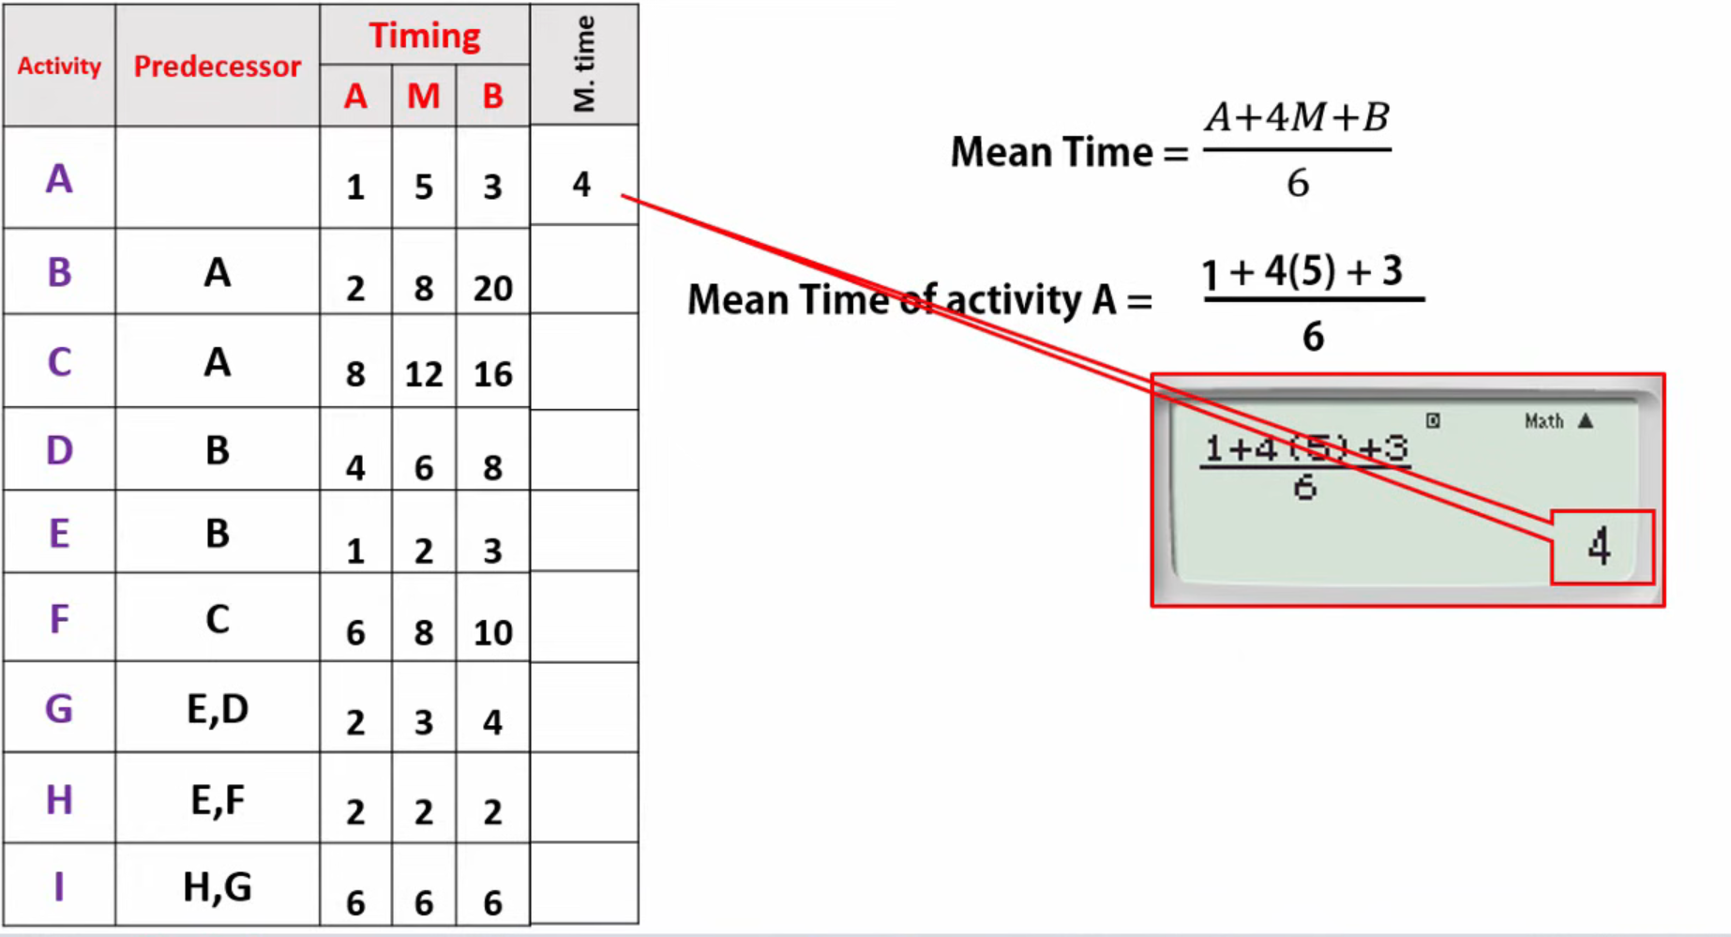

Slide 60
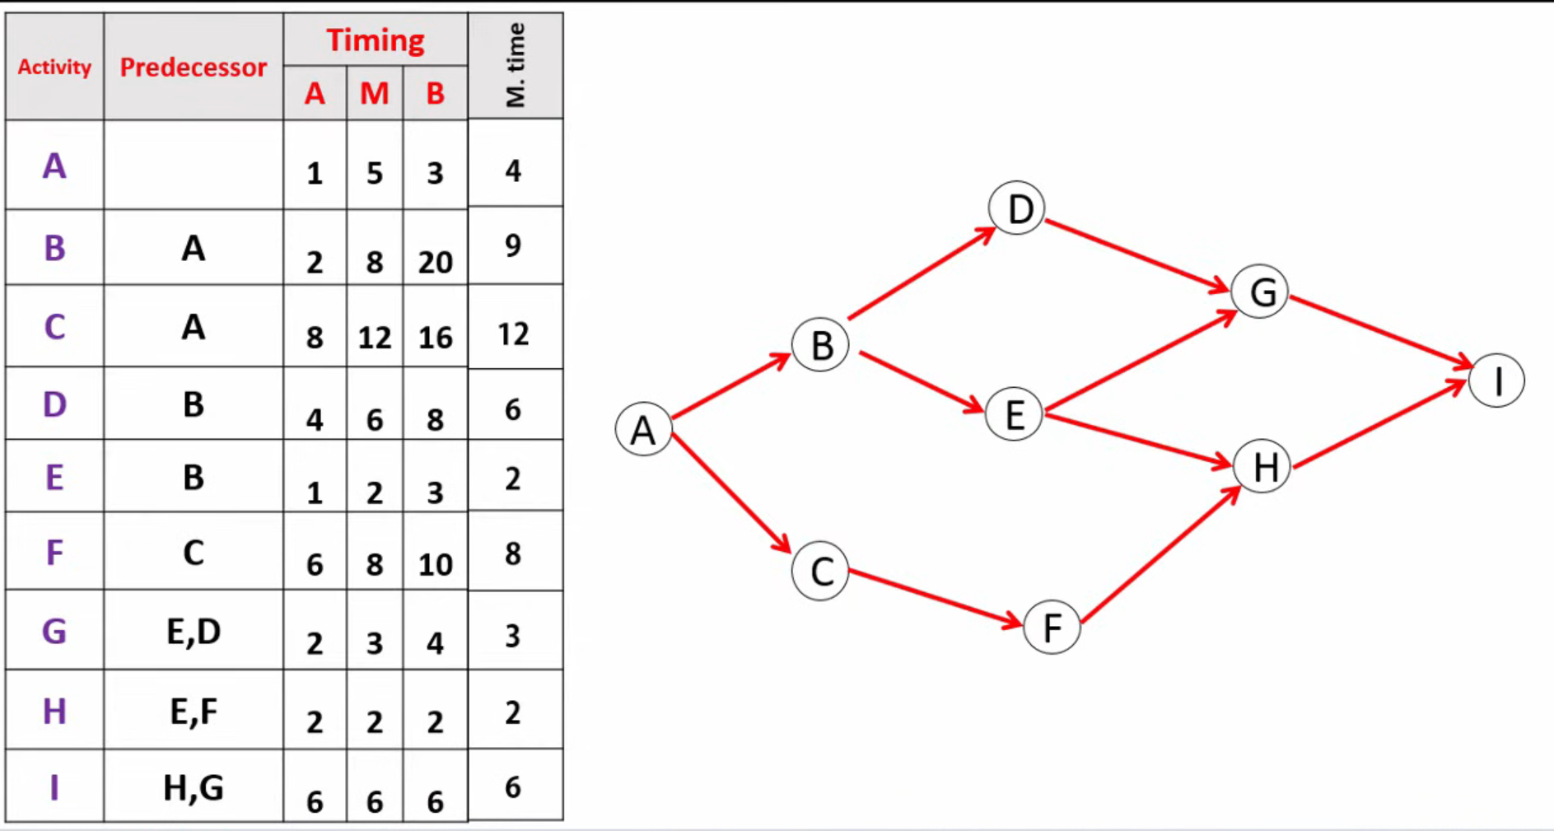

Slide 61
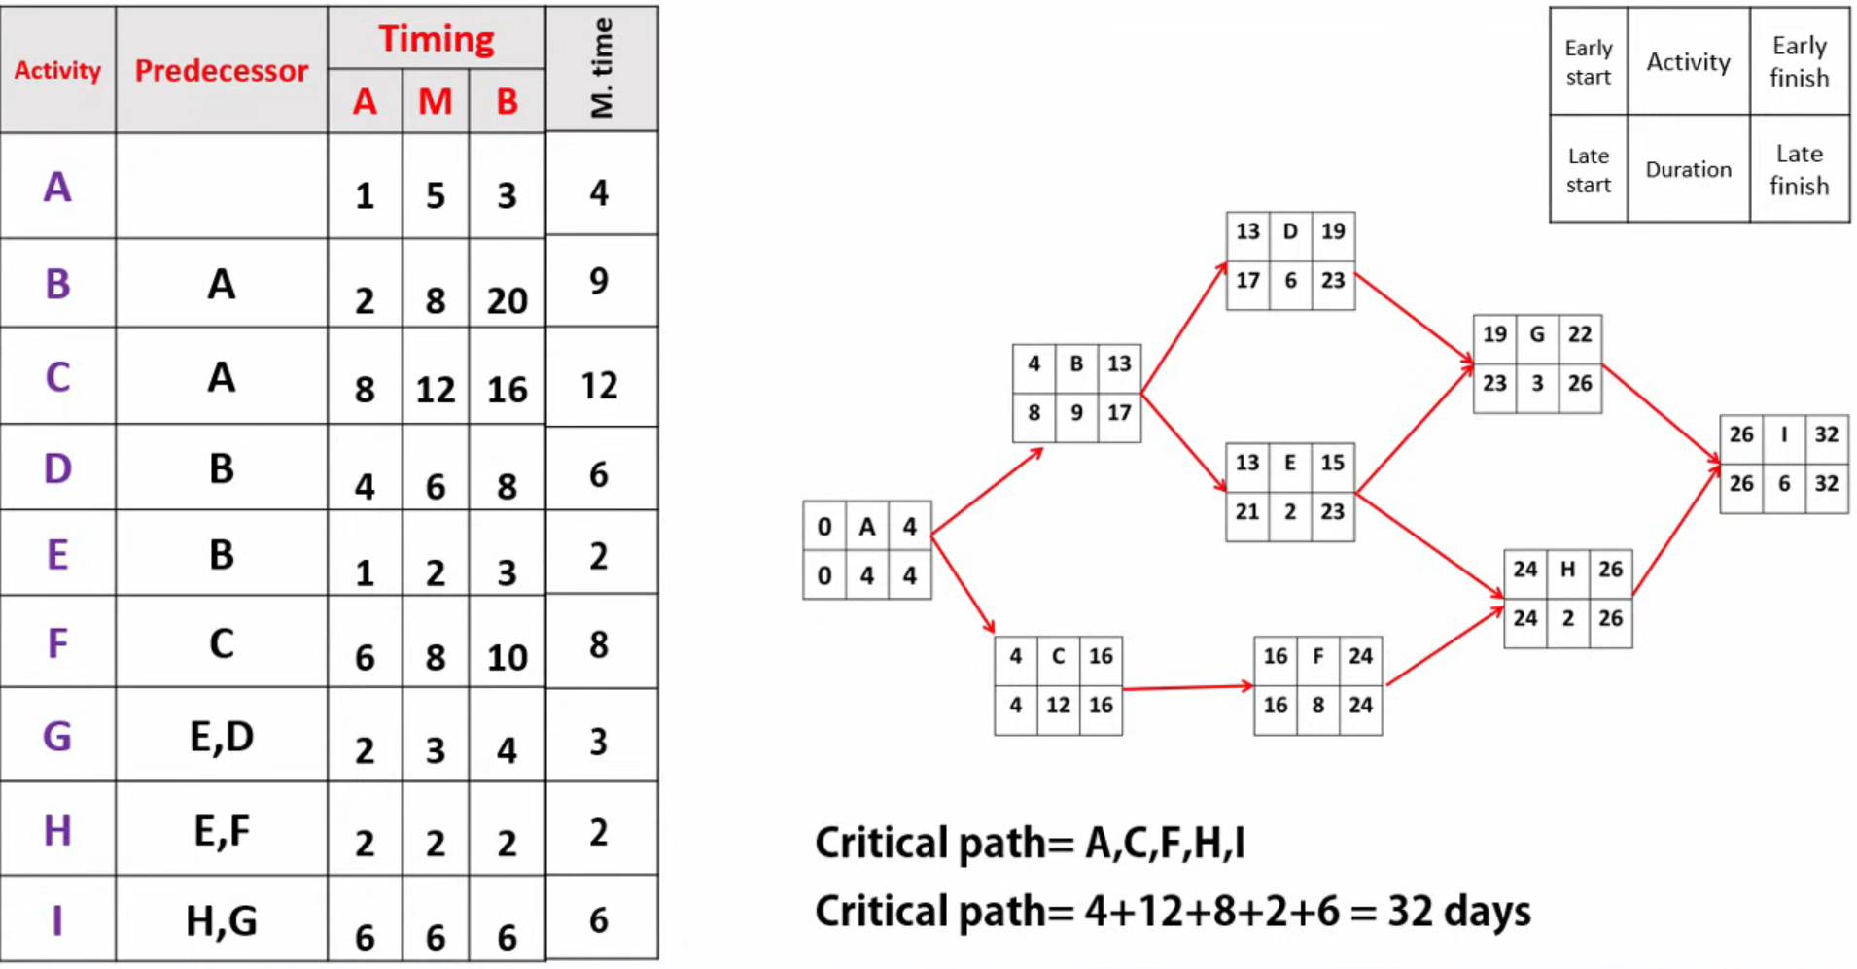

Slide 62
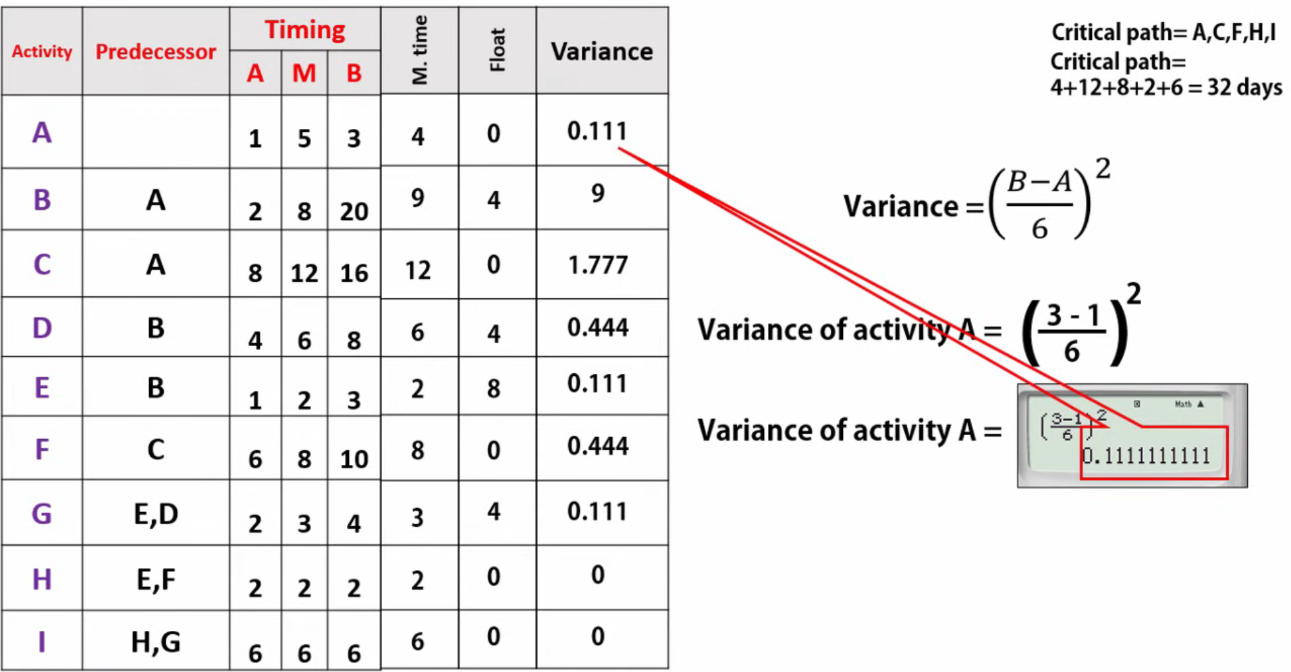

Slide 63
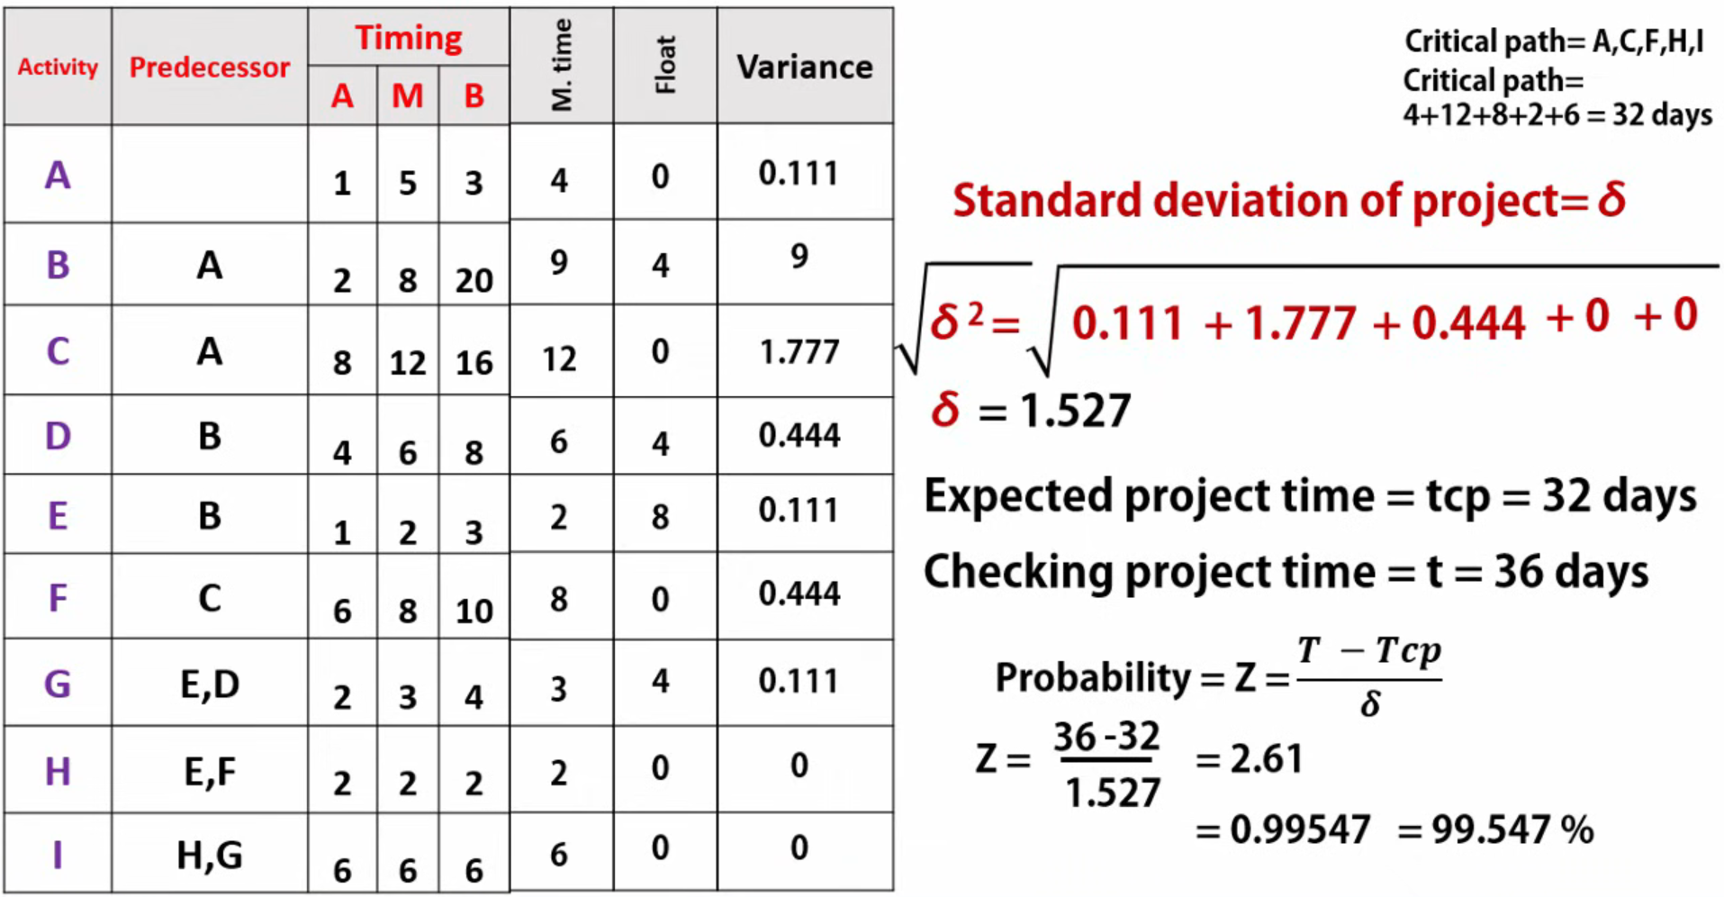

Slide 65
PERT vs CPM
Key Conceptual Differences
CPM
Assumes activity durations are known and stable
Emphasizes schedule control and crashing
Best when project activities are well understood
PERT
Assumes durations are uncertain
Uses statistical analysis
Best when project involves risk and innovation
Simple Example
CPM Example
Building a house Past data available → durations fixed → CPM suitable
PERT Example
Developing a new drug High uncertainty → multiple time estimates → PERT suitable

